Slide 1
HTML Code (Part 1)
<!DOCTYPE html>
<html lang="en">
<head>
<meta charset="UTF-8">
<title>Shritij | Portfolio</title>
<link rel="stylesheet" href="style.css">
</head>
<body>
<!-- Navigation -->
<nav>
<div class="logo">Shritij's Portfolio</div>
<ul>
<li><a
<li><a
<li><a
<li><a
<li><a
</ul>
</nav>
href="#home">Home</a></li> href="#about">About</a></li> href="#skills">Skills</a></li> href="#projects">Projects</a></li> href="#contact">Contact</a></li>
<!-- Hero Section -->
<section id="home" class="hero">
<h1>Hello, I'm <span>Shritij Jaiswal</span></h1>
<p>Aspiring Developer • Learner • Tech Enthusiast</p>
<a href="#projects" class="btn">View My Work</a>

Slide 2
HTML Code (Part 2)
</section>
<figure>
<img class="myImage" src="me.jpeg" width="200px" height="200">
<figcaption class="figcaption">Shritij Jaiswal</figcaption>
</figure>
<!-- About Section -->
<section id="about" class="about">
<h2>About Me</h2>
<p><strong>I enjoy coding, exploring new technologies, and building small
projects.
My goal is to improve step by step and create
code.</strong>
</p>
</section>
meaningful things using
<!-- Skills Section -->
<section id="skills" class="skills">
<h2>Skills</h2>
<div class="skill-box">
<p>Python</p>
<p>HTML & CSS</p>
<p>C Programming</p>
<p>Java (Basics)</p>
</div>
</section>

Slide 3
HTML Code (Part 3)
<!-- Projects -->
<section id="projects" class="projects">
<h2>Projects</h2>
<div class="project-card">
<h3>1. Basic Calculator</h3>
<p>A simple command-line calculator.</p>
</div>
<div class="project-card">
<h3>2. Number Guessing Game</h3>
<p>Guess a random number within attempts.</p>
</div>
<div class="project-card">
<h3>3. Snake Water Gun</h3>
<p>Fun Python game with choices.</p>
</div>
</section>
<section id="contact" class="contact">
<h2>Contact</h2>
<p>Email: shritijjaiswal27@gmail.com</p>
<a href="https://www.linkedin.com/in/shritij-jaiswal-7542b6370">My LinkedIn</a>
</section>

Slide 4
HTML Code (Part 4)
</body>
</html>

Slide 5
CSS Code (Part 1)
/* Basic Setup */
body { margin: 0; padding: 0; font-family: Arial; background: skyblue; color: grey; } html { scroll-behavior: smooth; }
/* Navigation */
nav { display: flex; justify-content: space-between; padding: 15px 40px; background:
black; nav ul nav ul
}
{ display: flex; gap: 25px; }
li a { color: gray; text-decoration: none; }
/* Hero */
.hero { text-align: center; padding: 80px 20px; }
.profile-pic { width: 150px; height:150px; border-radius: 50%; }
.hero h1 span { color: #f39c12; }
.btn { padding: 10px 20px; background:#f39c12; border-radius:5px; }
/* Sections */
.about, .skills, .projects, .contact { text-align:center; padding:60px 20px; }
.skill-box p { background:white; padding:10px; margin:8px auto; width:200px; }
/* Projects */
.project-card { margin:15px auto; padding:20px; width:60%; border-left:5px solid black;
}
/* Buttons */
.linkedin-btn { background:#0A66C2; padding:10px 20px; color:white; border-radius:5px;
}

Slide 6
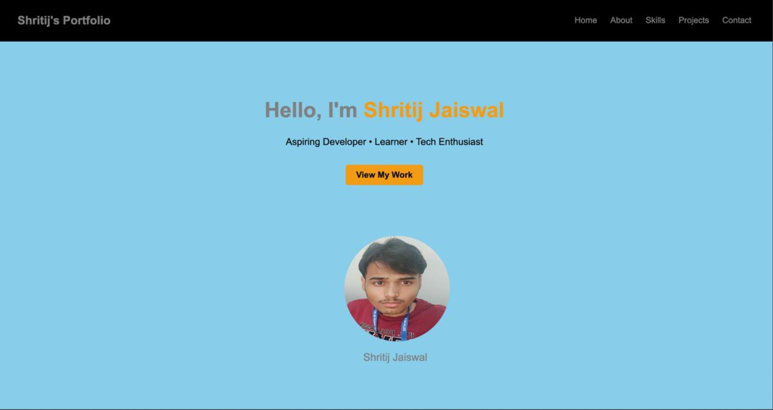
CSS Code (Part 2)
/* Image */
.myImage { margin-left:619px; border-radius:50%; }
.figcaption { font-size:20px; color:gray; }

Slide 7
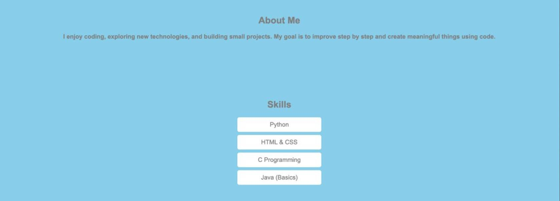

Slide 8
